Slide 1
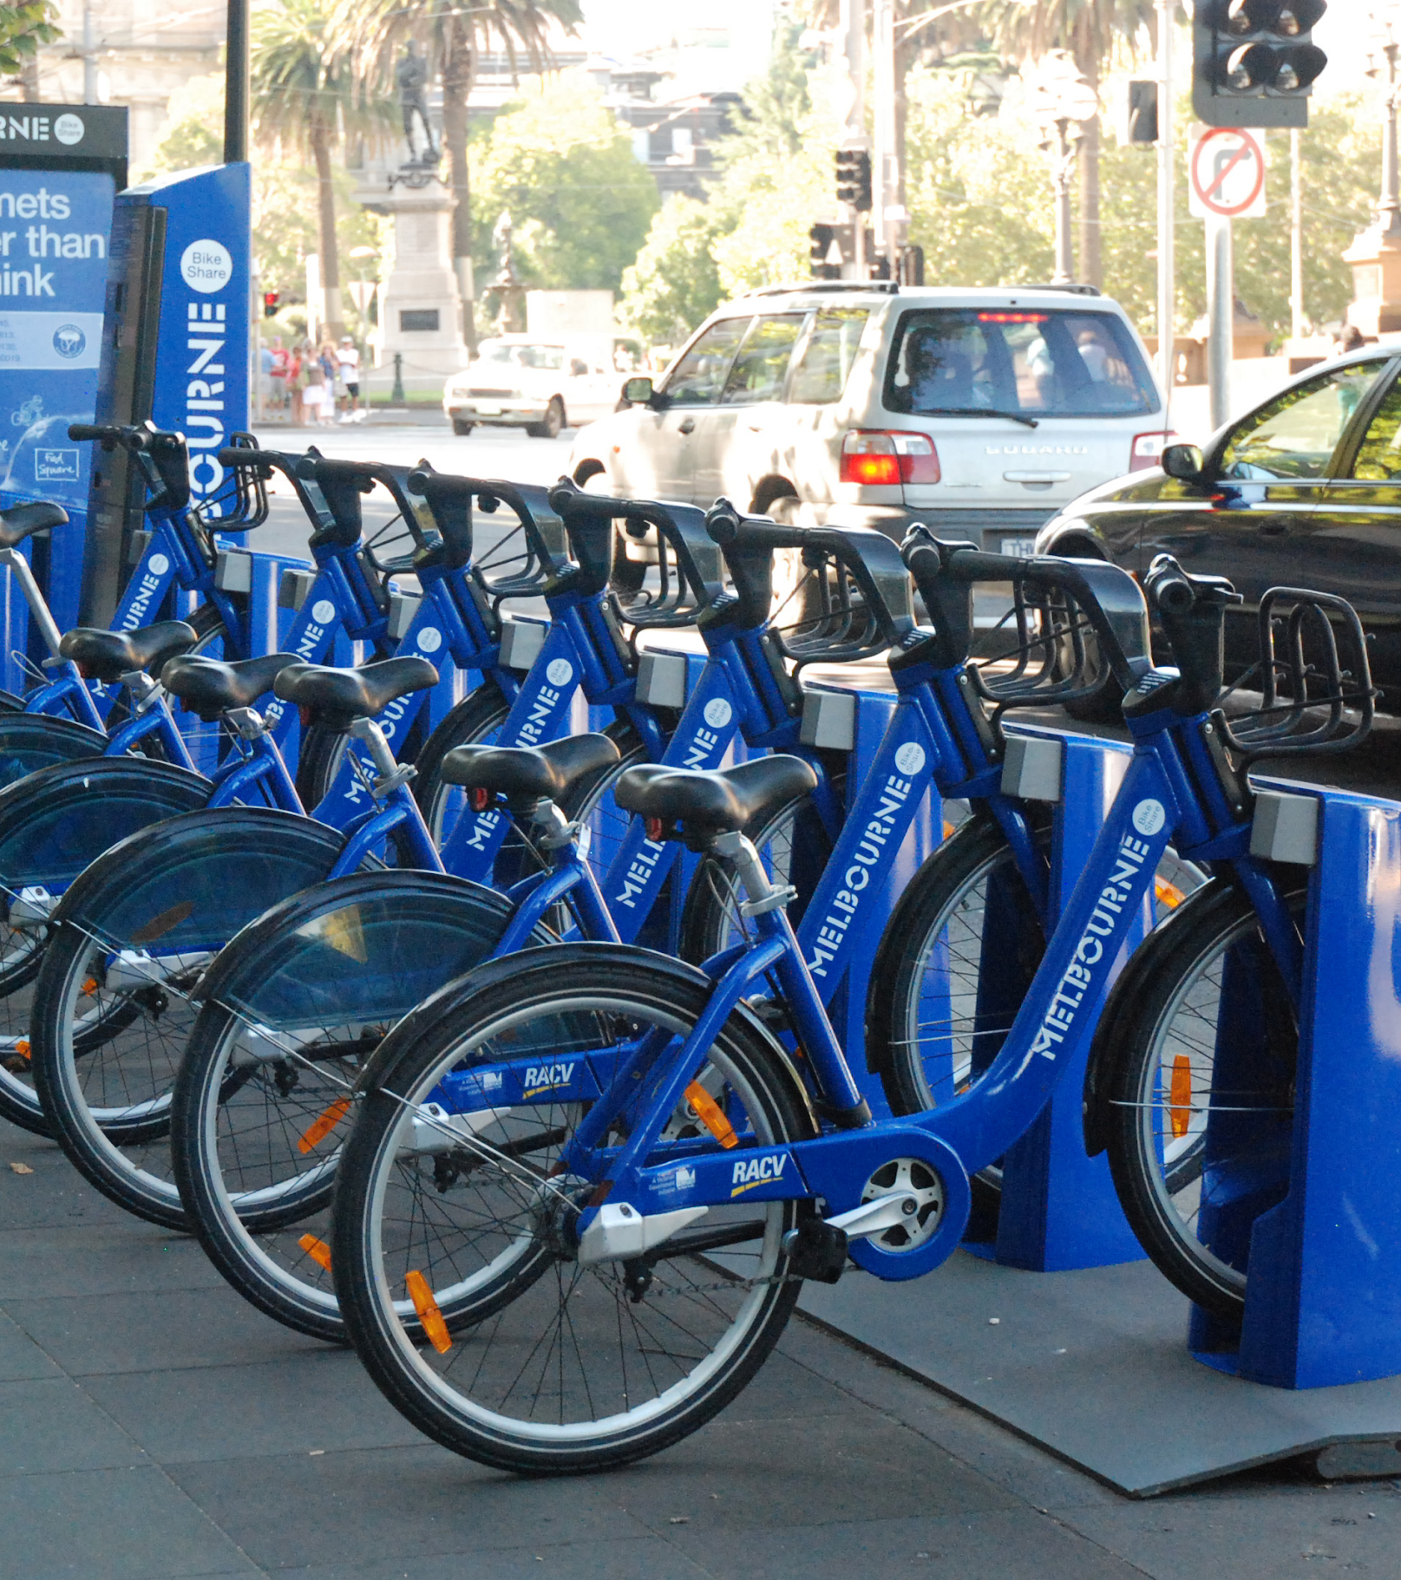


DC TAXI AND BIKESHARE DATA ANALYSIS
Group 17
Yifan Dang, Yupeng Cui, Beixuan Jia, Huimin Han, Yusheng Ge

Slide 2
AGENDA
Data Preprocessing
Used Bigquery to selected the key variables(e.g. zip codes, ID, Duration) by join the two table.
Filtered out the zip codes within the DC areas, and kept the data only after 2017.
Removed any abnormal values and numeric outliers by python (e.g. keep every input value within 3 standard deviation from mean)
Data Visualization
Plotted the geography distribution of both taxis and bikes in Tableau determine the characteristics of region where either one dominates.
Find the relationships between average time spends, average distances and average money in each areas divided by zip code and generalizes interesting thoughts.
Bike share

Slide 3
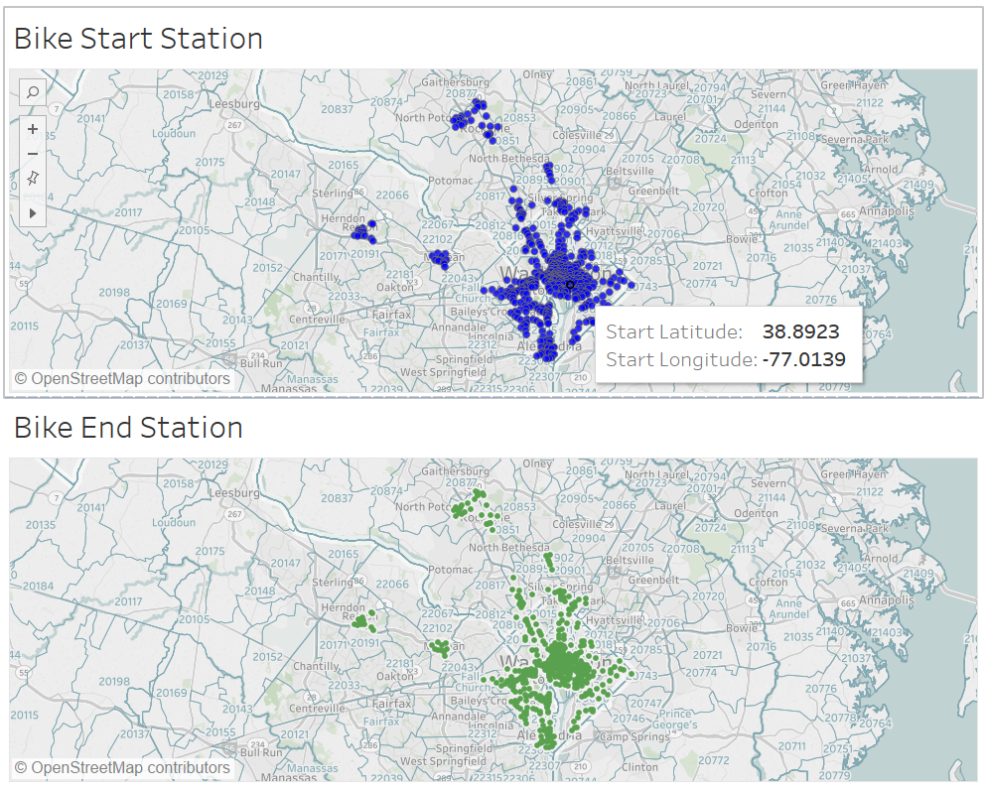
NAVIGATION

Slide 4
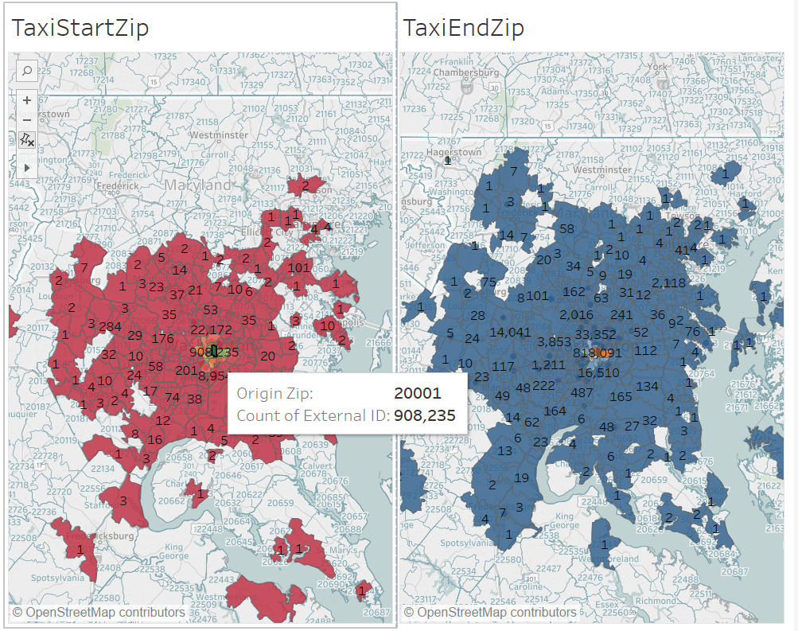
REGULATORY COMPLIANCE AND TRAINING
Look in the slide notes below for topics to consider talking about
Notes:
Consider talking about:
Australia
New Zealand

Slide 5
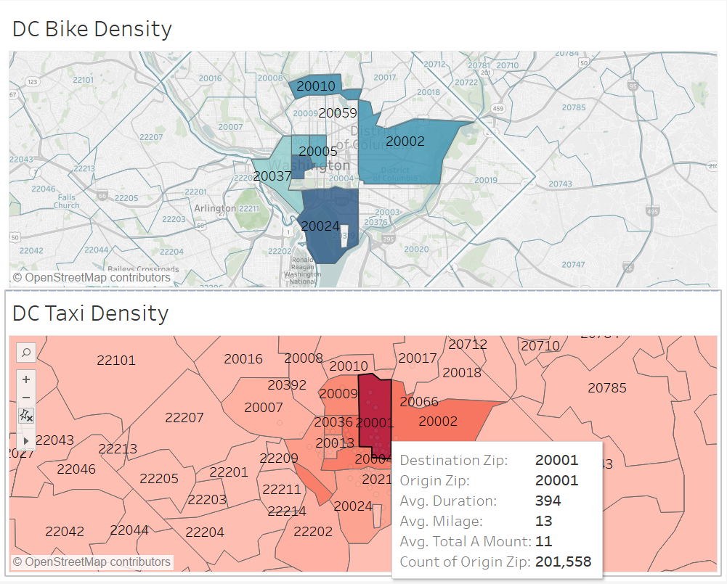

Slide 6
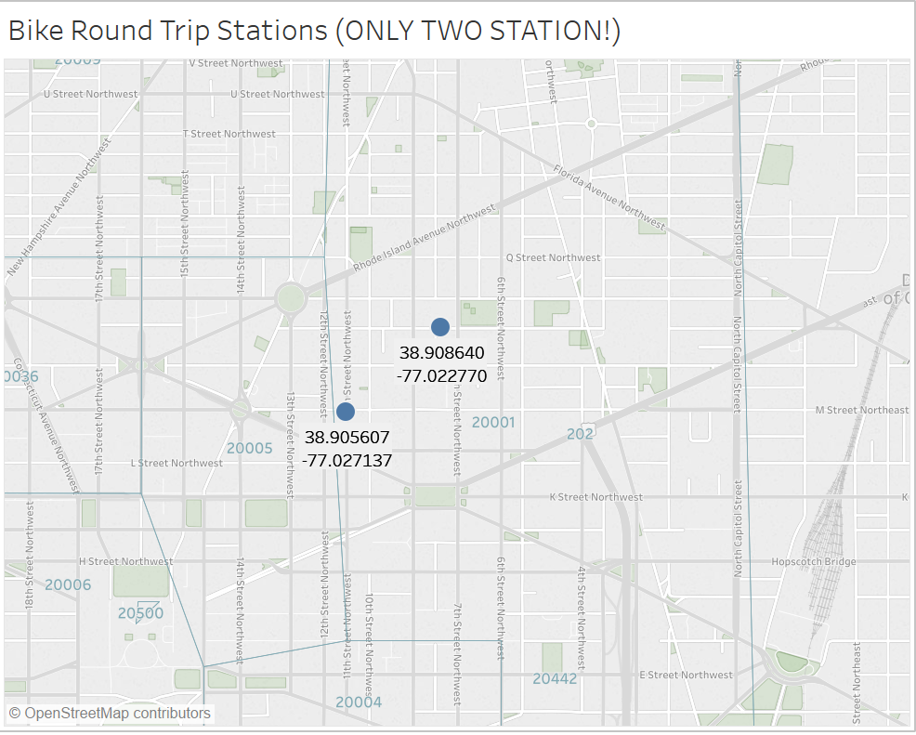
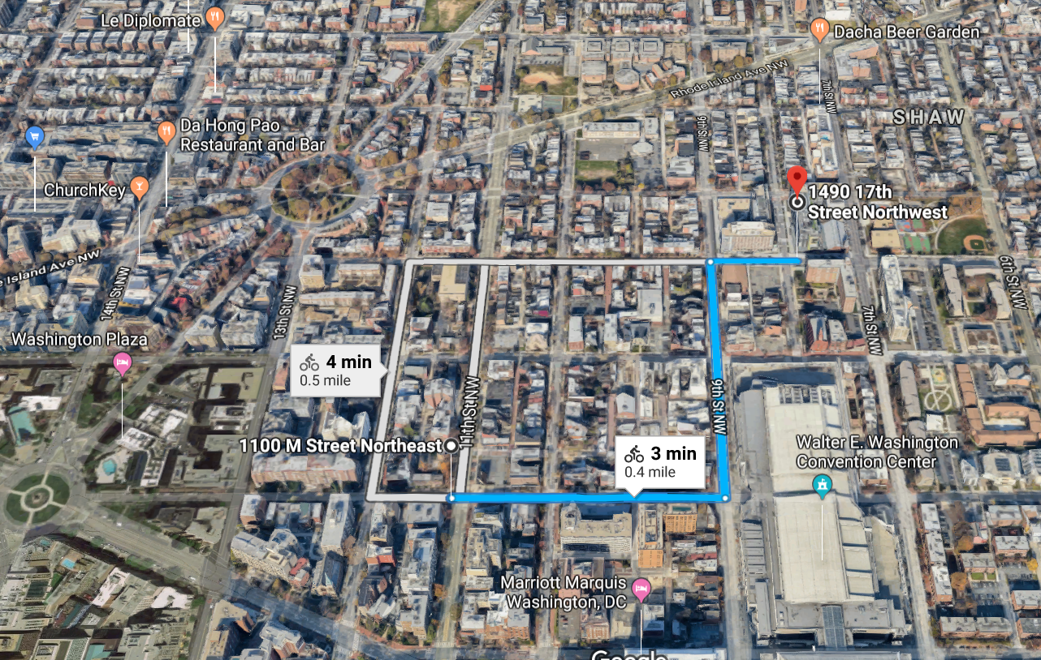
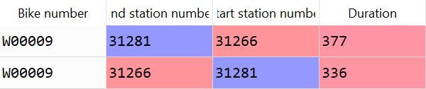
OCCUPATIONAL HAZARDS

Slide 7
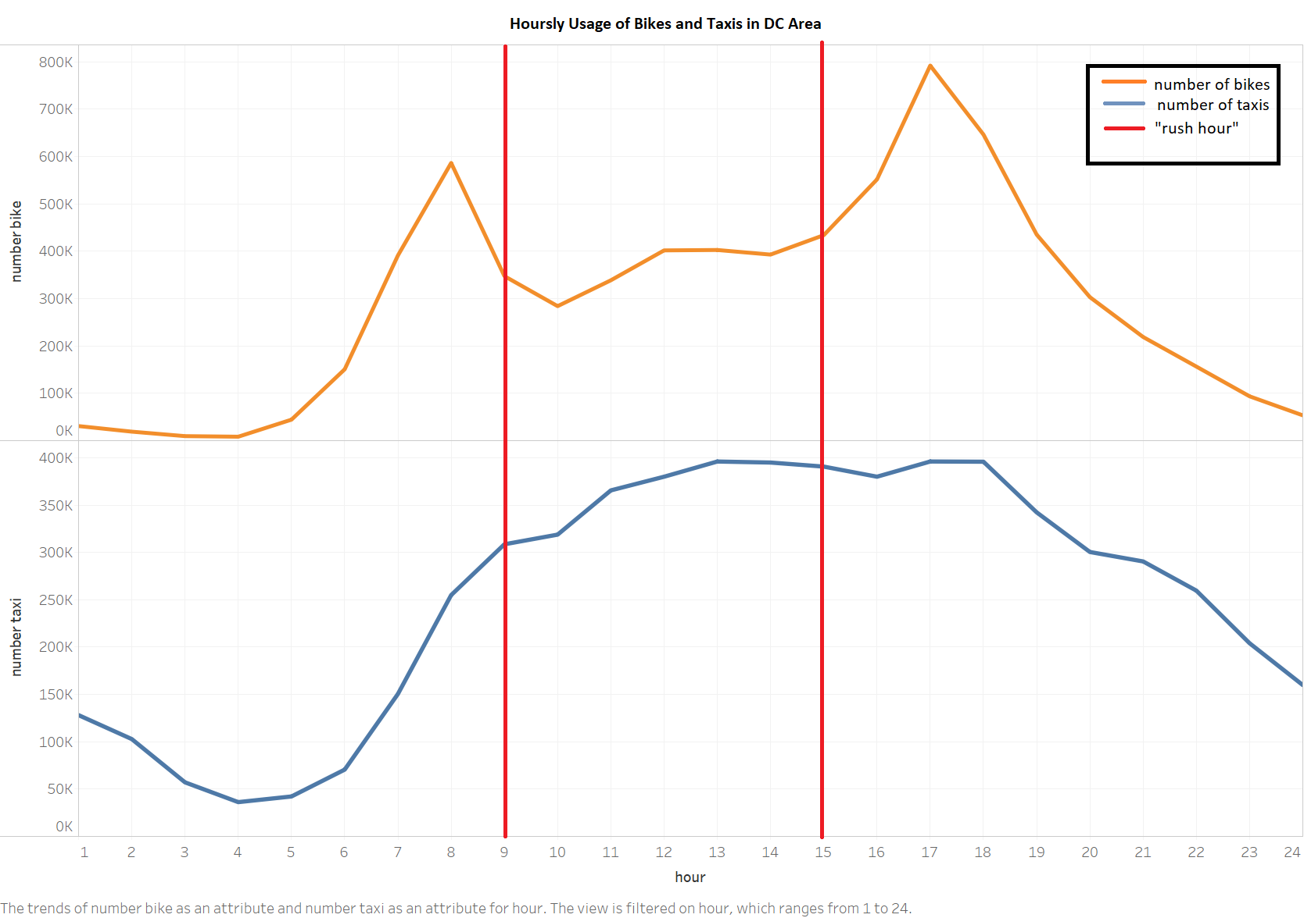
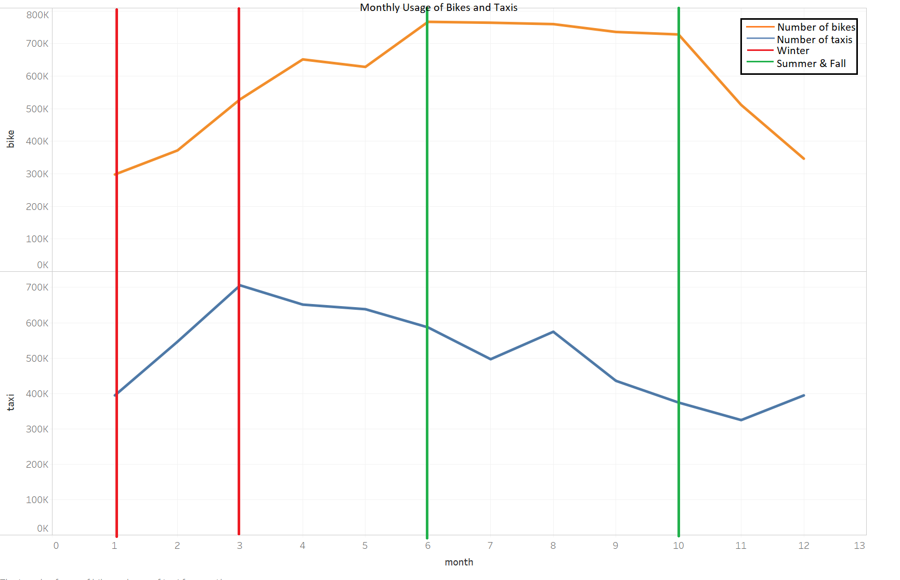

Slide 8
SUGGESTIONS
The Taxi Company should avoid the zip code areas which has higher bikers, such as the area 20024, focus on the areas where the bikes appear less.
Avoiding the areas which mileage in the unit time is blow 90 percentages of distribution. Because those areas high not driver favor or not cost-efficiency.
Pay attentions to the bike stations where the Universities and shopping center is nearby, Because people in those areas tend to use bike for round trips.

